Slide 1
APPLIED FUZZY HEURISTIC FOR GREEDY NODE DETECTION IN VANETS
MEMBERS:
M.ANUPRIYA
P.POOJA
K.DHIVYABARATHI
GUIDE:
MRS.R.VENITTA RAJ
Department of Information Technology
Mepco Schlenk Engineering College
Department of IT

Slide 2
PROBLEM STATEMENT
High mobility-VANETs
Detection algorithm-GDVAN
Department of IT

Slide 3
Existing System:
VANETs-subclass –MANETs
Wireless communication
Communication depends on networks
Routing depends on routing protocol
Preestablished infrastructure are called AD hoc networks
Self governing nodes
Department of IT

Slide 4
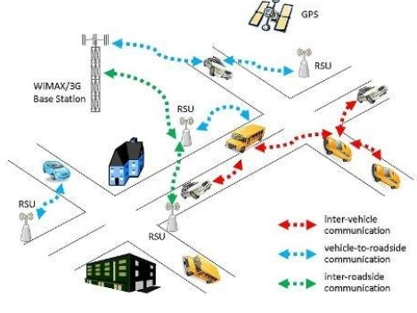
Department of IT

Slide 5
Contd..
In MANETs 3 families:
New MAC Design Based Solutions:
Monitoring-Based Solutions:
Game Theory-Based Solutions:
Department of IT

Slide 6
DISADVANTAGE:
Flooding in route discovery initial phase.
Wasted band width.
Delay.
Increasing network congestion.
Bad performances between sources and destination.
Department of IT

Slide 7
Literature Survey[1]
High mobility of nodes,geographic extension-not always applicable
Prescence of dishonest peers-unwanted situation
Department of IT

Slide 8
Literature Survey[2]
Security and privacy-not work well in VANETs
Vehicle’s signature-it is difficult to verify for RSU(road side unit)
Department of IT

Slide 9
Literature Survey[3]
MANETs on IEEE 802.11-do not extend to 802.11p
Department of IT

Slide 10
Literature Survey[4]
Normal nodes-transmission slow due to waiting time
Greedy nodes-transmission fast
Department of IT

Slide 11
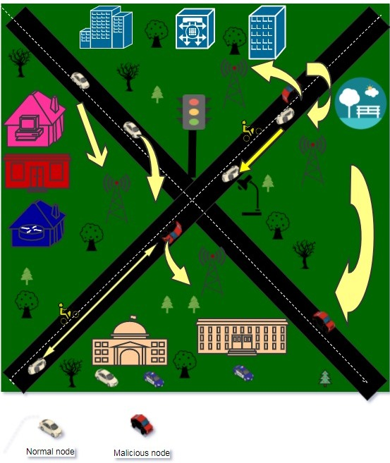
System Architecture
Department of IT

Slide 12
Contd..
Two phases:
The suspicion phase
The decision phase.
The suspicion phase linear regression
The decision phase fuzzy logic
List out the potentially compromised nodes using three newly defined metrics.
Department of IT

Slide 13
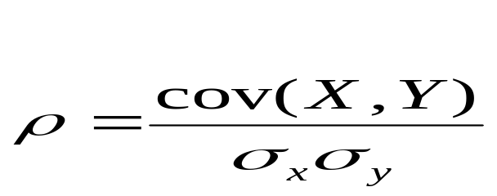
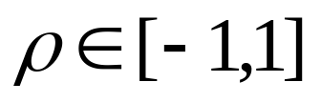
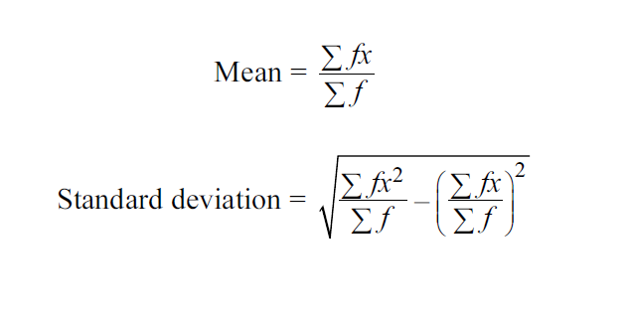
Correlation Coefficient
Department of IT

Slide 14
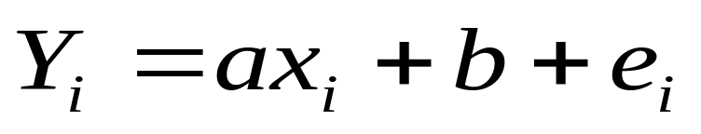
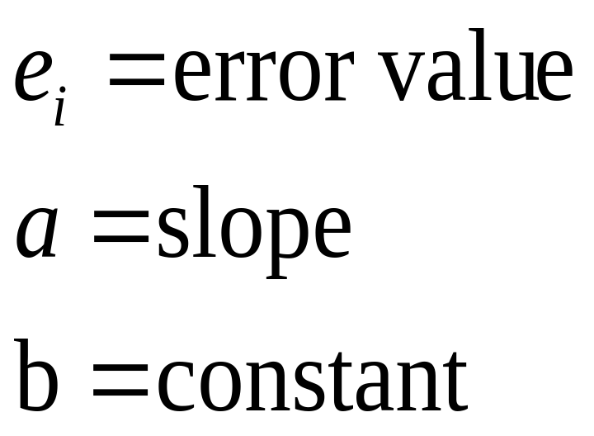
The Linear Regression Concept
Department of IT

Slide 15
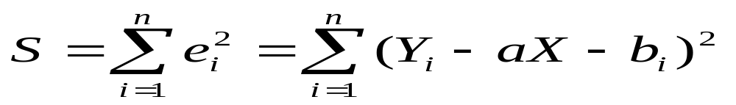
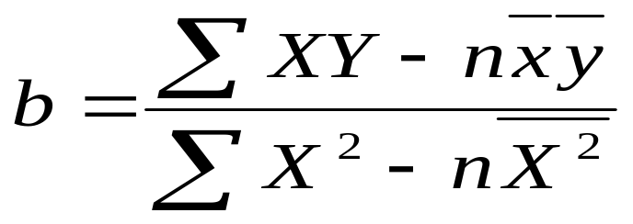
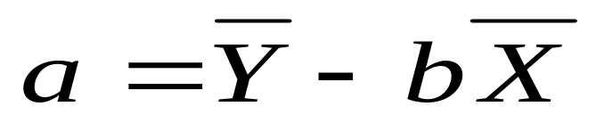
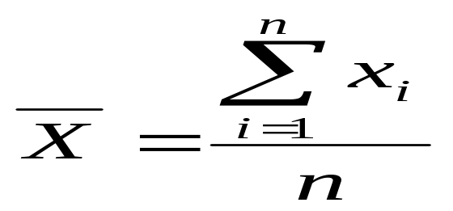
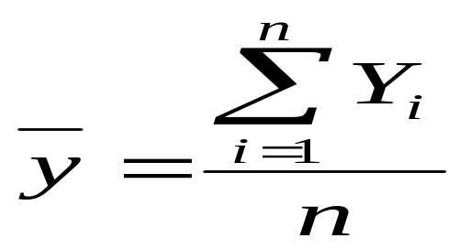
Department of IT

Slide 16
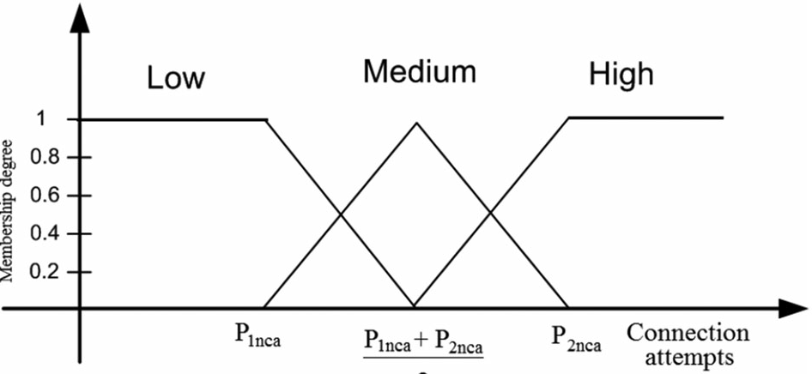
Fuzzification and Membership Degree
Switch from real to fuzzy domain.
we define the membership to ‘‘Low’’, ‘‘Medium’’ and ‘‘High’’, denoted by L,M and H.
Ms:U->[0,1]
Department of IT

Slide 17
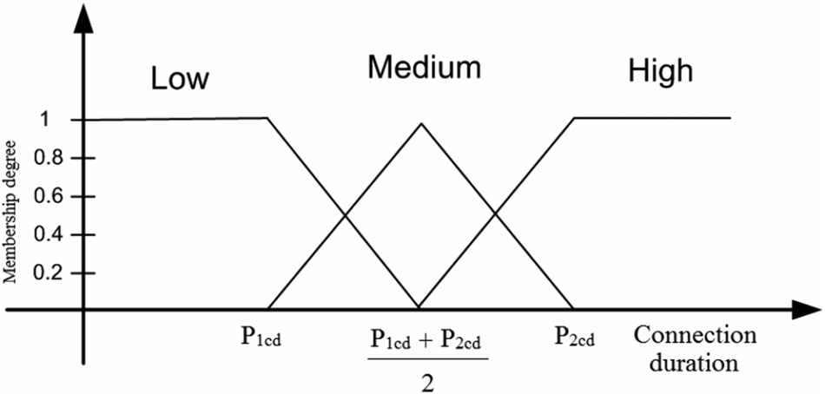
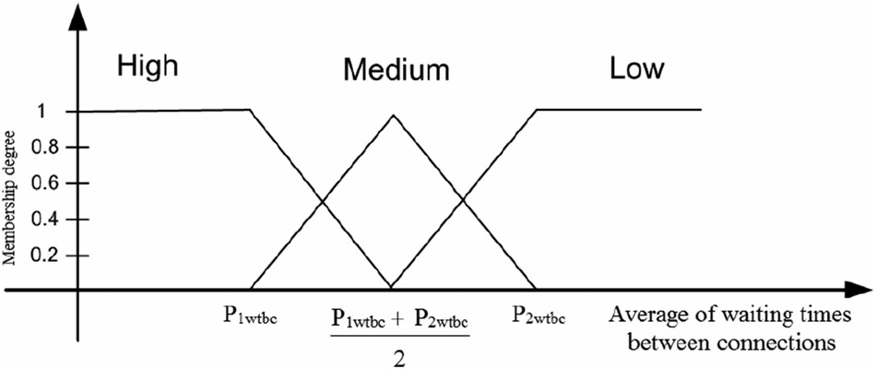
Department of IT

Slide 18
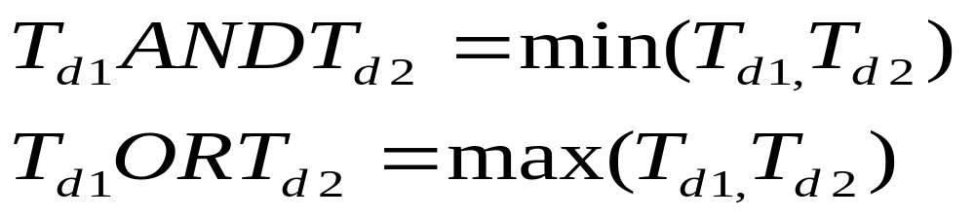
Decision Rules
connect - inputs with the outputs
Normal ,Suspected and Greedy -N, S and G.
Formula:IF(condition)THEN(condition)
The truth degree Td of an attribute e is given by
Department of IT

Slide 19
Fuzzy rules of Class1 formula
Fuzzy rules of Class formula
V1 | L | M | H
V2
L | N | N | S
M | N | S | S
H | S | G | G
CLASS1 | N | S | G
V3
N | N | S | G
S | N | S | G
G | S | G | G
Department of IT

Slide 20
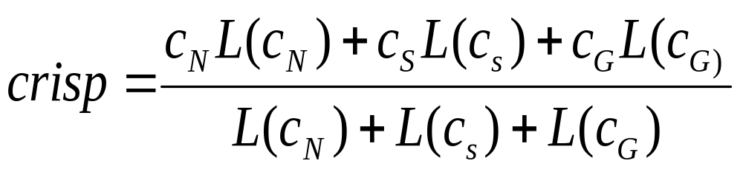
Defuzzification
Provide an exact final value
Its called crisp value.
Department of IT

Slide 21
Code Hyperlinks
Program
Department of IT

Slide 22

Screen Shots
Department of IT

Slide 23
REFERENCES
[1].M. N. Mejri, M. Hamdi, "Recent advances in cryptographic solutions for vehicular networks", Proc. Int. Symp. Netw. Comput. Commun., pp. 1-7, 2015.
[2] 2013, [online] Available: http://grouper.ieee.org/groups/scc32/dsrc/.
[3]. S. Buchegger, J.-Y. Le Boudec, "Performance analysis of the confidant protocol", Proc. 3rd ACM Int. Symp. Mobile ad hoc Netw. Comput., pp. 226-236, 2002.
[4]. A. Hamieh, J. Ben-Othman, A. Gueroui, F. Naït-Abdesselam, "Detecting greedy behaviors by linear regression in wireless ad hoc networks", Proc. IEEE Int. Conf. Commun., pp. 1-6, 2009.
Department of IT

Slide 24
        THANK YOU
Department of IT

